Slide 1
ENGT 3510
Chapter 7
Point Estimation of Parameters and Sampling Distributions

Slide 2
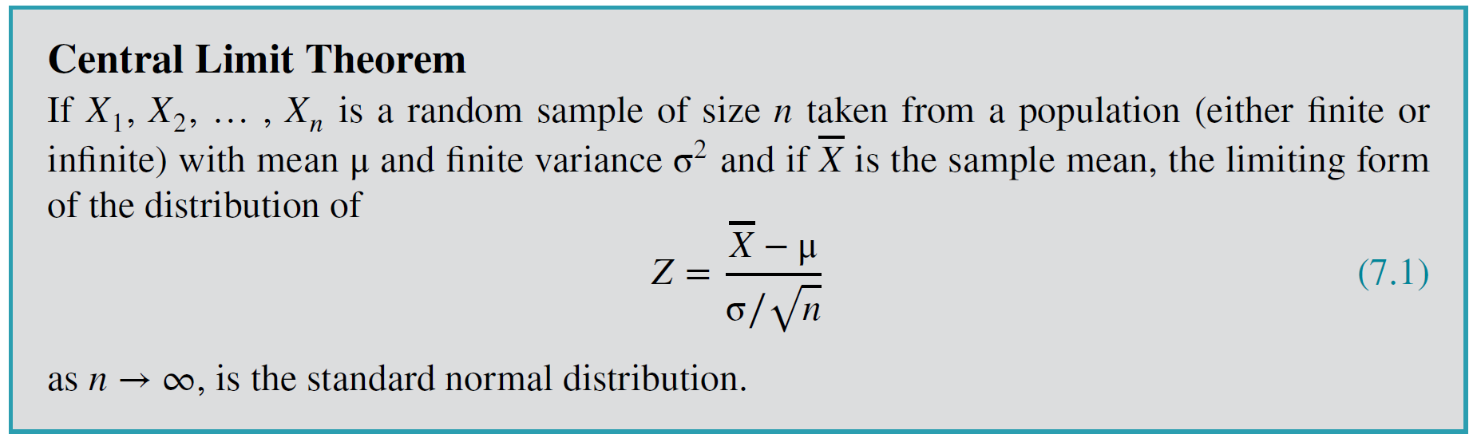

Introduction
A population that has an unknown probability distribution, the sampling distribution of the sample mean will still be approximately normal with mean $μ$ and variance $\frac{σ^{2}}{n}$ if the sample size $n$ is large.

Slide 3
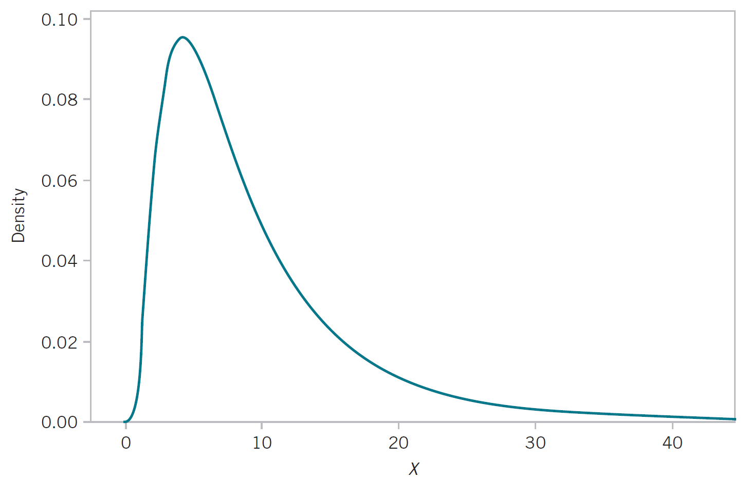
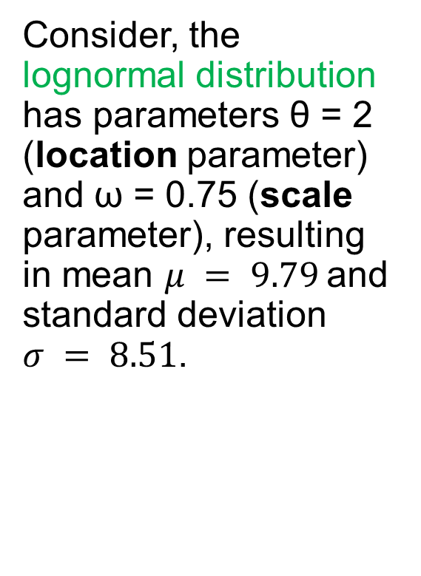
Central Limit Theorem
Consider, the lognormal distribution has parameters θ = 2 (location parameter) and ω = 0.75 (scale parameter), resulting in mean $μ = 9.79$and standard deviation $σ = 8.51$.

Slide 4
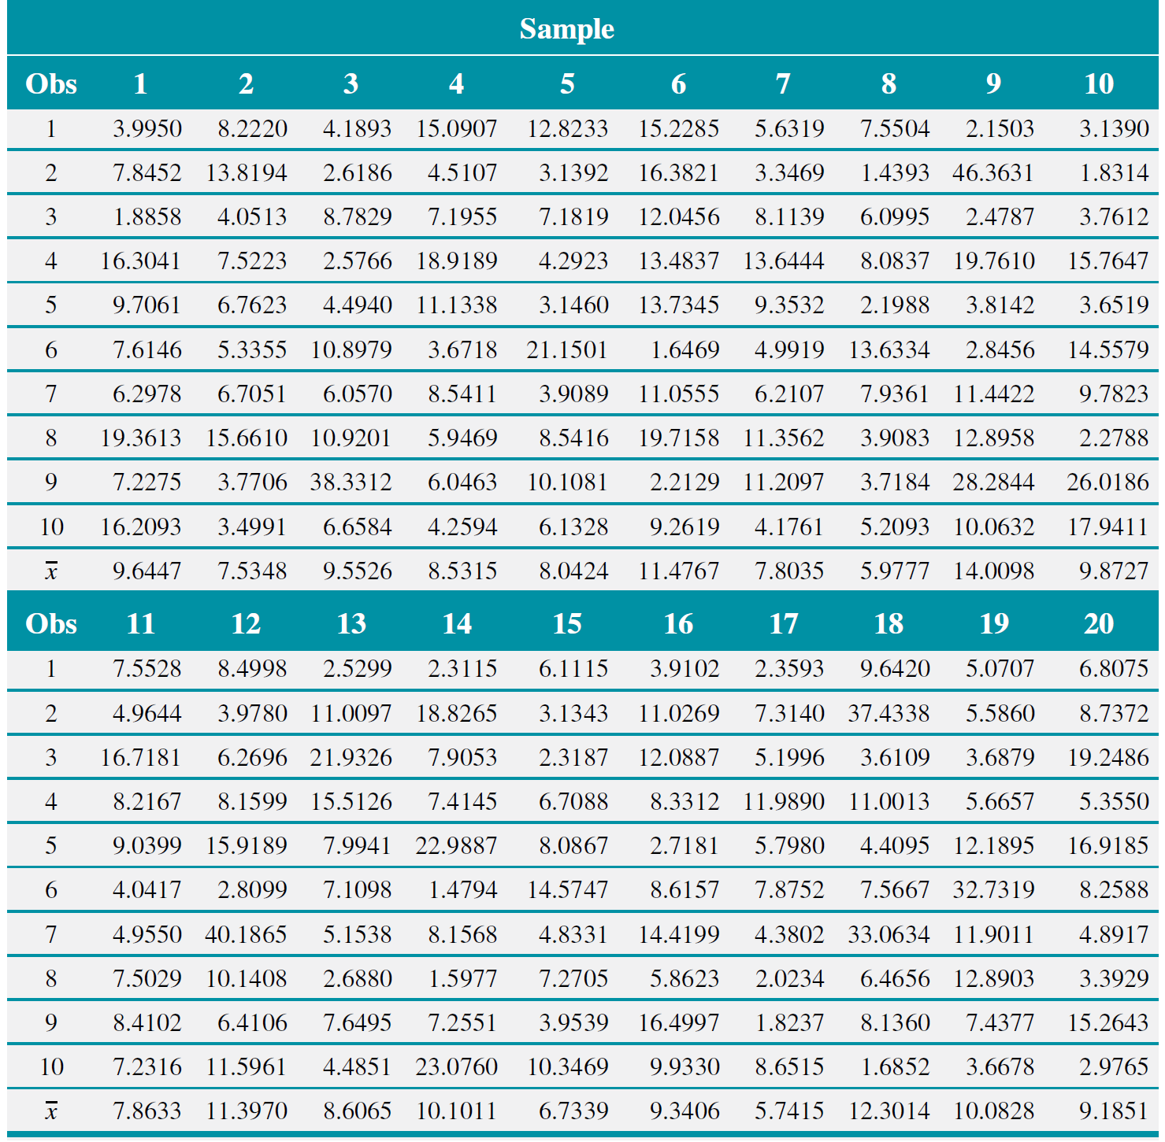

20 random samples with $n=10$ were drawn from the population

Slide 5
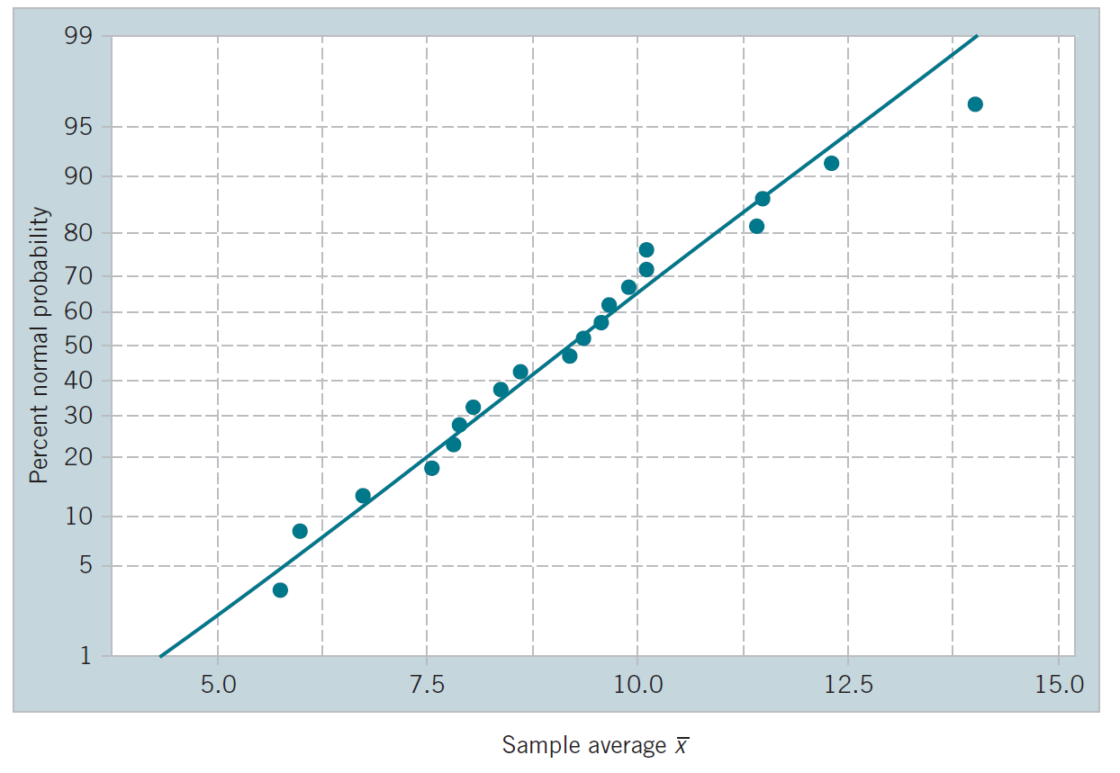
Central Limit Theorem
Normal Probability Plot

Slide 6
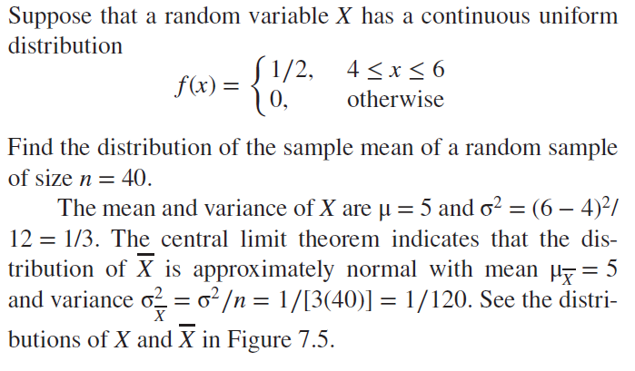
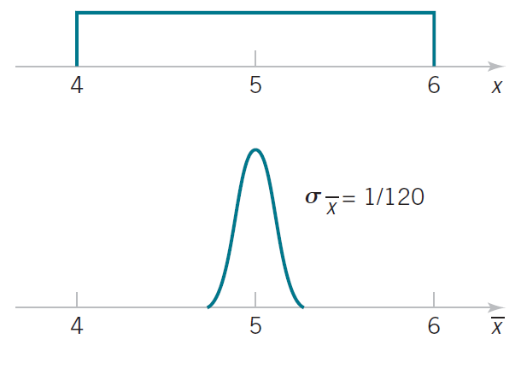
Central Limit Theorem
Example

Slide 7

Central Limit Theorem
Example: An electronics company manufactures resistors that have a mean resistance of 100 ohms and a standard deviation of 10 ohms. The distribution of resistance is normal. Find the probability that a random sample of n = 25 resistors will have an average resistance of fewer than 95 ohms.
Solution
Given, $μ_{\overline{X}}=100, σ_{\overline{X}}=\frac{σ}{\sqrt{n}}=\frac{10}{\sqrt{25}}=2$
$$P\left(\overline{X}<95\right)=P\left(Z<\frac{95−100}{2}\right)$$
$$=P\left(Z<−2.5\right)=Φ\left(−2.5\right)=0.0062$$

Slide 8
Central Limit Theorem
Solution
Interpretation: If the distribution of resistance is normal with mean 100 ohms and standard deviation of 10 ohms, finding a random sample of resistors with a sample mean less than 95 ohms is a rare event. If this actually happens, it casts doubt as to whether the true mean is really 100 ohms or if the true standard deviation is really 10 ohms.

